Slide 1

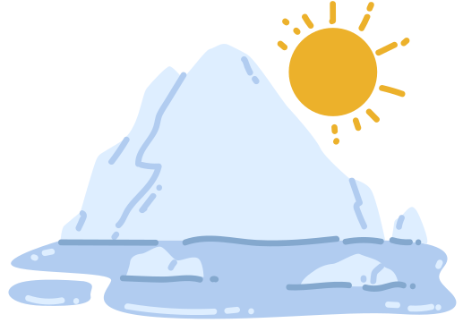
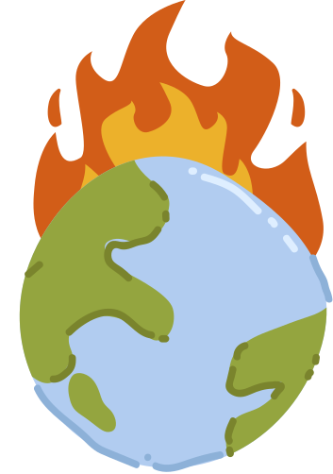
The Impact of
Climate Change

Slide 2
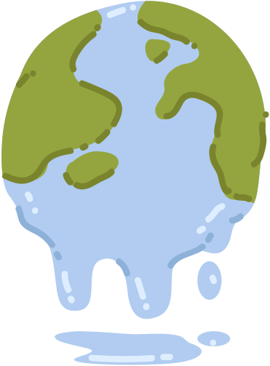
What is Climate Change?
Climate change is when the Earth's usual climate (the weather patterns over a long time) starts to change. It's like the Earth is getting a little warmer. It happens because of something called the "greenhouse effect."

Slide 3

The Greenhouse Effect
Picture a greenhouse where plants grow. Sunlight comes in through the glass, but some of it gets trapped inside, making it warmer. The Earth has a natural "blanket" of gases like carbon dioxide and methane. But when we use a lot of cars and factories, we add more of these gases, making the Earth warmer, like a greenhouse.

Slide 4

What Happens When it Gets Warmer?

Slide 5
Melting Ice
Think about what happens when it's too hot outside. Ice cream melts, right? Well, something similar happens to ice at the North and South Poles. It melts and makes the sea level rise. This can be a problem for animals and people who live near the water.

Slide 6
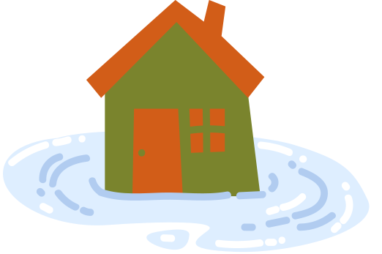
Crazy Weather
The Earth might have more storms, floods, or droughts. This can make it harder for plants, animals, and people to live in some places.

Slide 7


Migrating Animals
Some animals and plants might not like the warmer weather, so they have to find new homes. It's like if you had to move because your house became too hot.

Slide 8
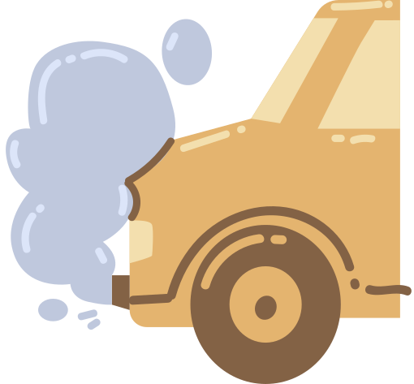
What Can We Do to Make it Better?

Slide 9
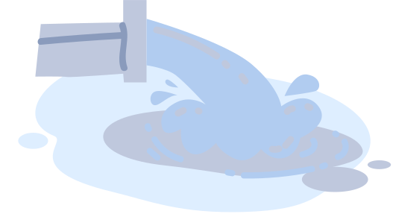
Use Less Stuff
When we use less electricity and water, it's like giving the Earth a break. Turn off lights, unplug electronics, and don't waste water.

Slide 10
Plant Trees
Trees are like superheroes. They help clean the air by taking in the extra gases. Planting more trees is like inviting more superheroes to the Earth team.

Slide 11



Recycle
When we recycle, we're giving old things a new life. This means we don't have to make as many new things, which uses less energy and helps the Earth stay cooler.

Slide 12

Be a Nature Helper
Just like being a helper in class, we can be helpers to nature. Pick up trash when you see it, and be kind to animals. If we all work together, we can make the Earth a better place.

Slide 13
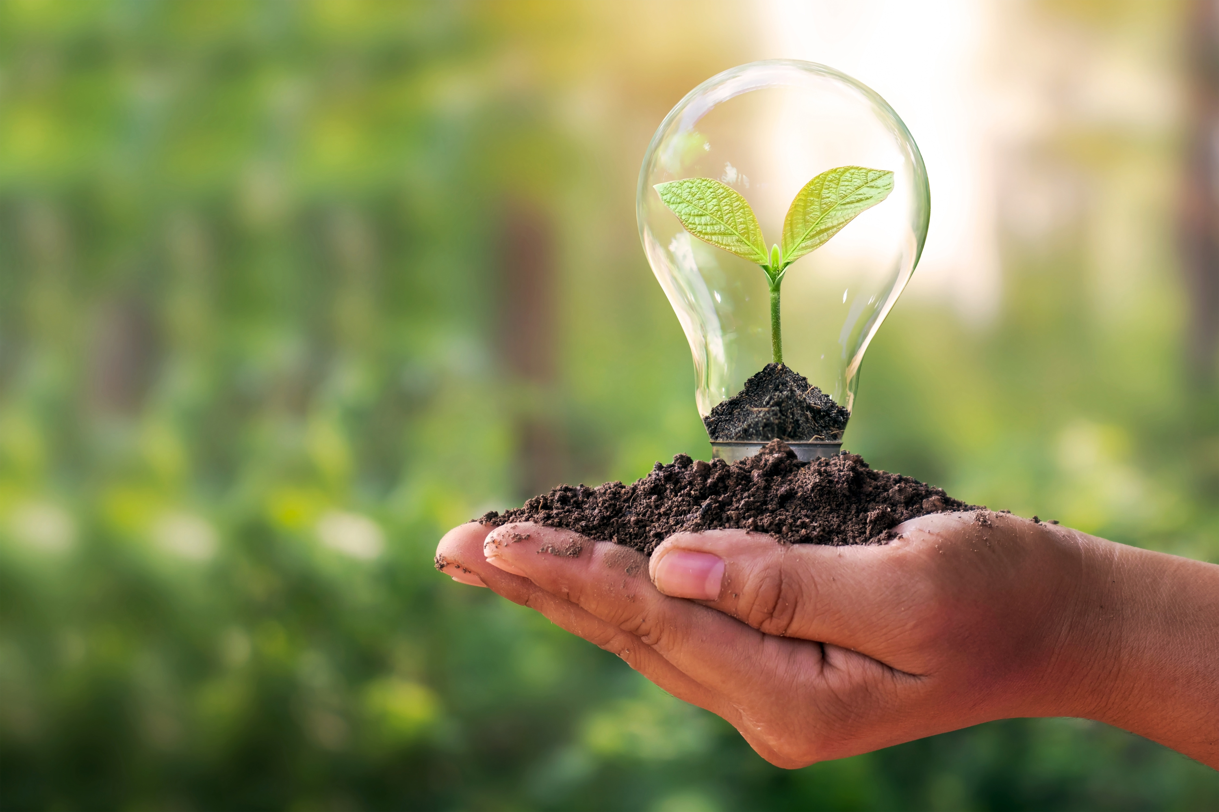
Know your emission,
take your action

